Slide 1
Samples
Time point Treatment | 2w | 4w | 10w | 12w
Veh (Sham-control) | 8 | 8 | 8 | 8
Scl (sclerostin treatment) | 8 |  | 8
PTH (parathyroid hormone treatment) |  | 8 |  | 8
Different expression analysis
pydeseq2
Sequencing raw data (.fq)
mm39
Alignment (.bam)
Pathway Enrichment
Pathfind.R
Gene count table
Venn
Network
Notes:
Similarity (PCA) between samples in the same group and among the group?
Change among time point (Veh 2,4,10,12w)? Make a table.

Slide 2
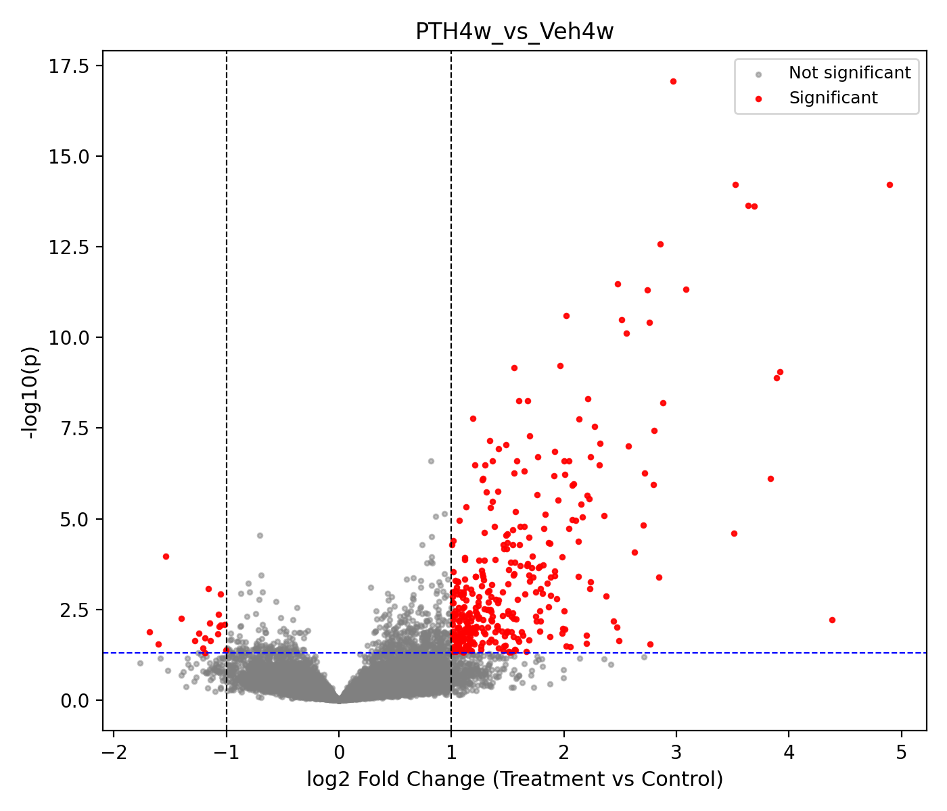
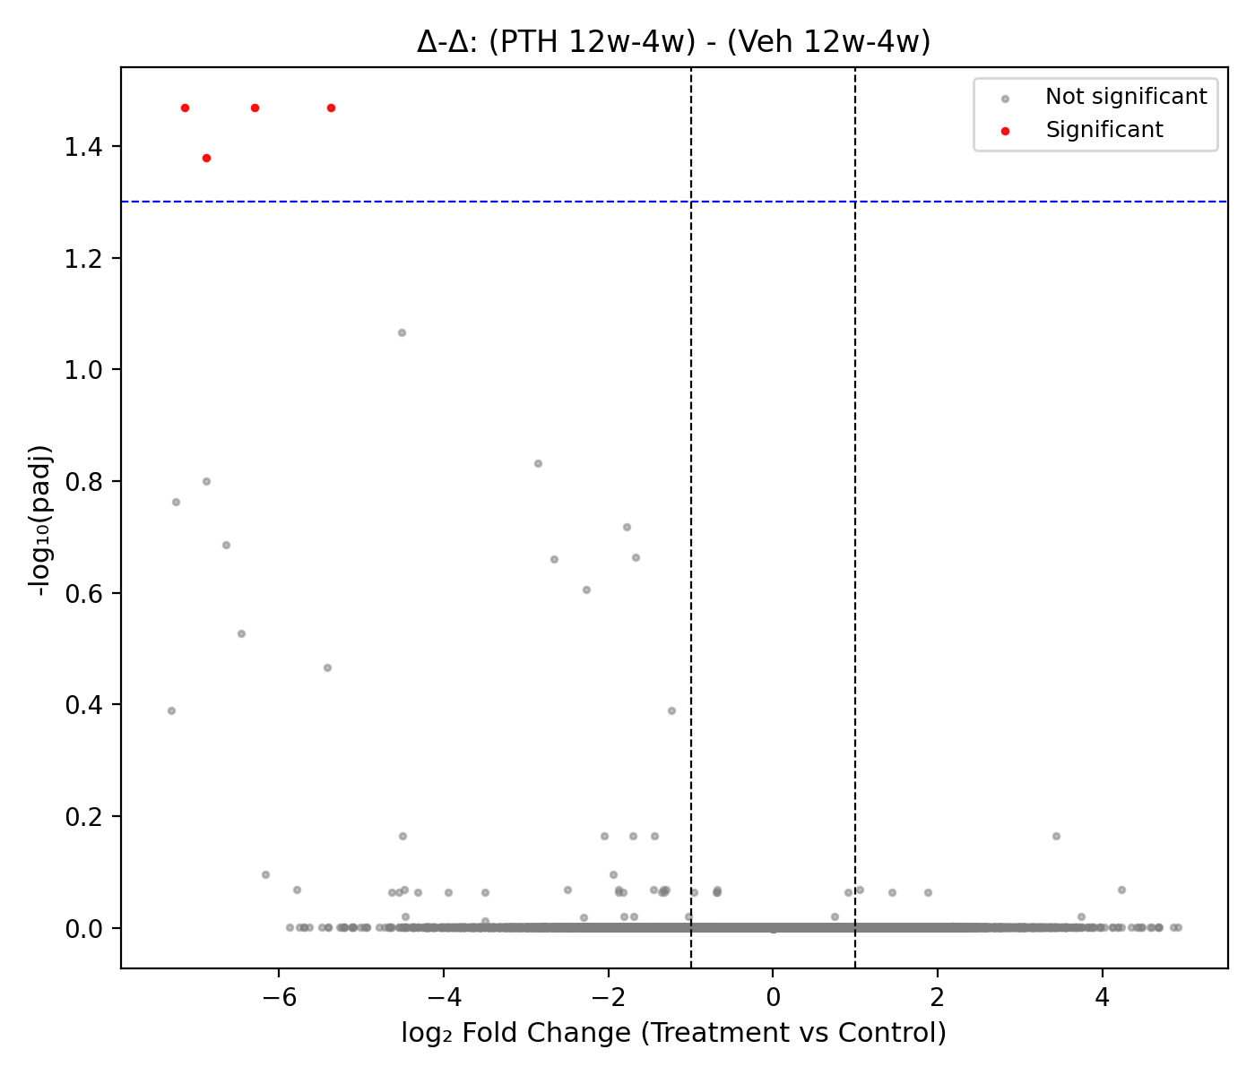
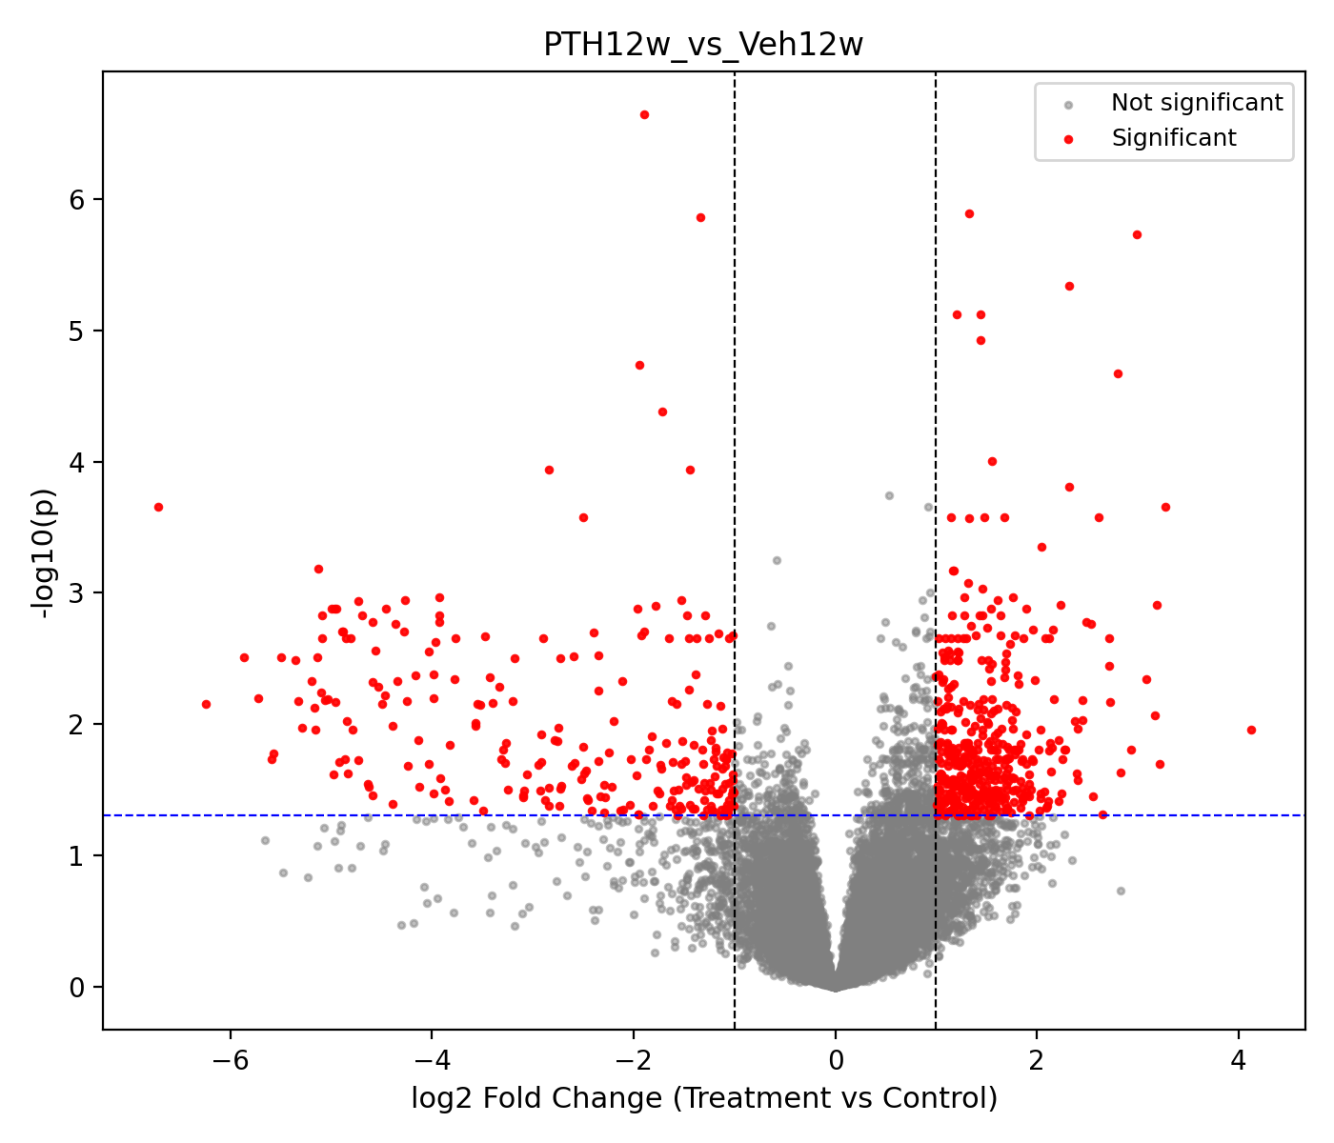
PTH vs Veh
Early stage
Late stage
(LogPTH12w – Log PTH4w) – (Log Veh10w – Log Veh2w)
pyDESeq2 interaction model

Slide 3
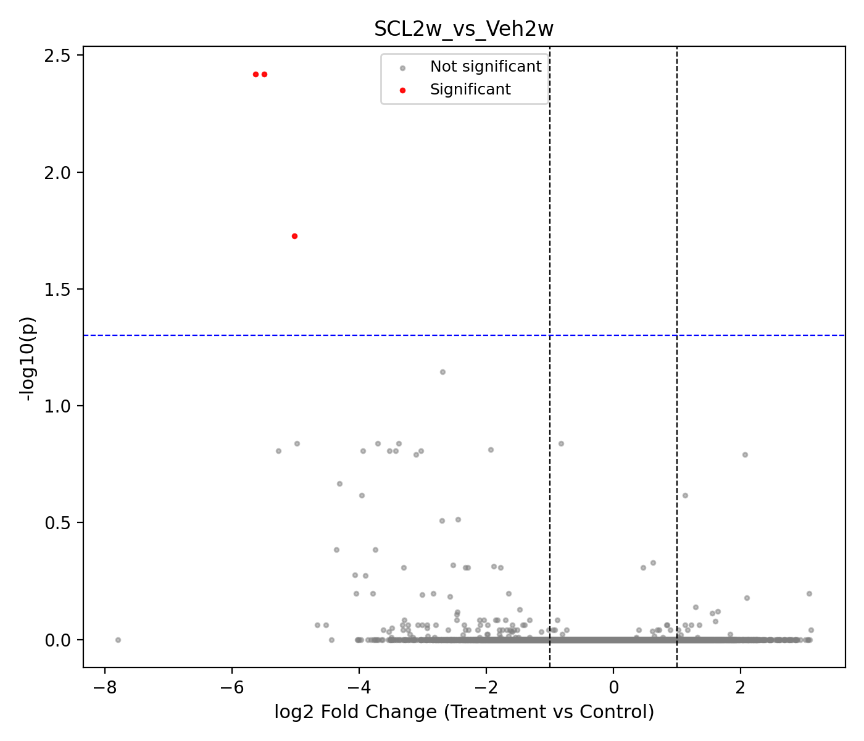
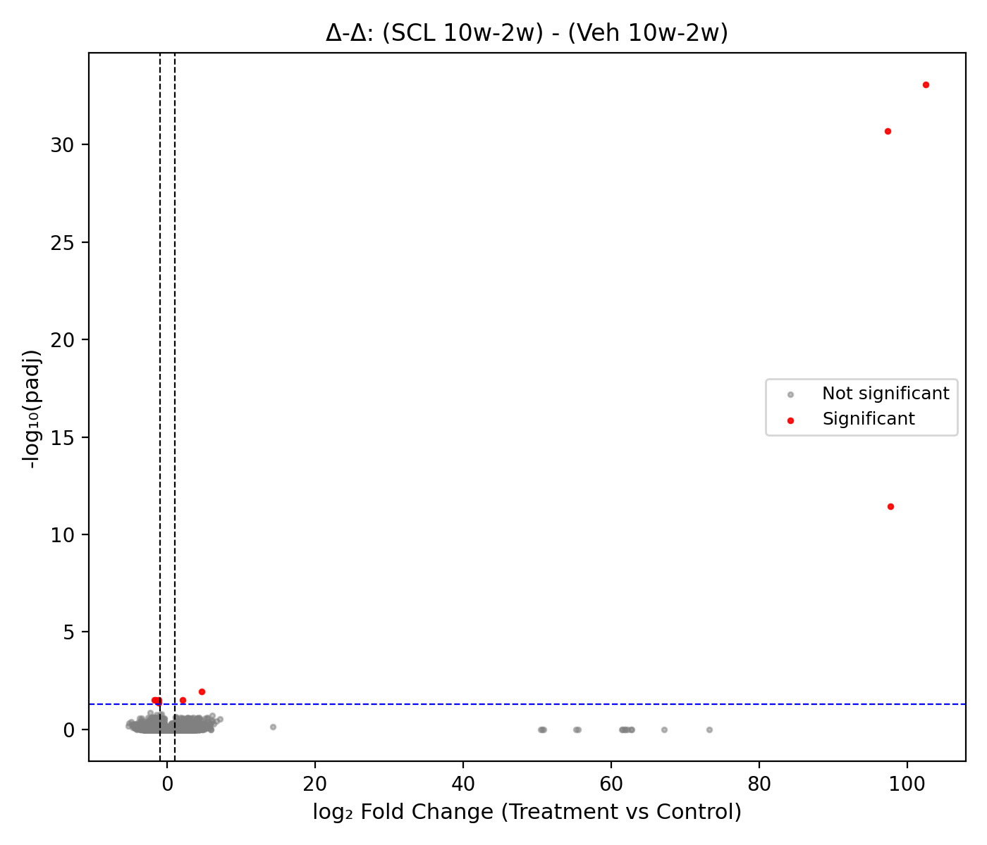
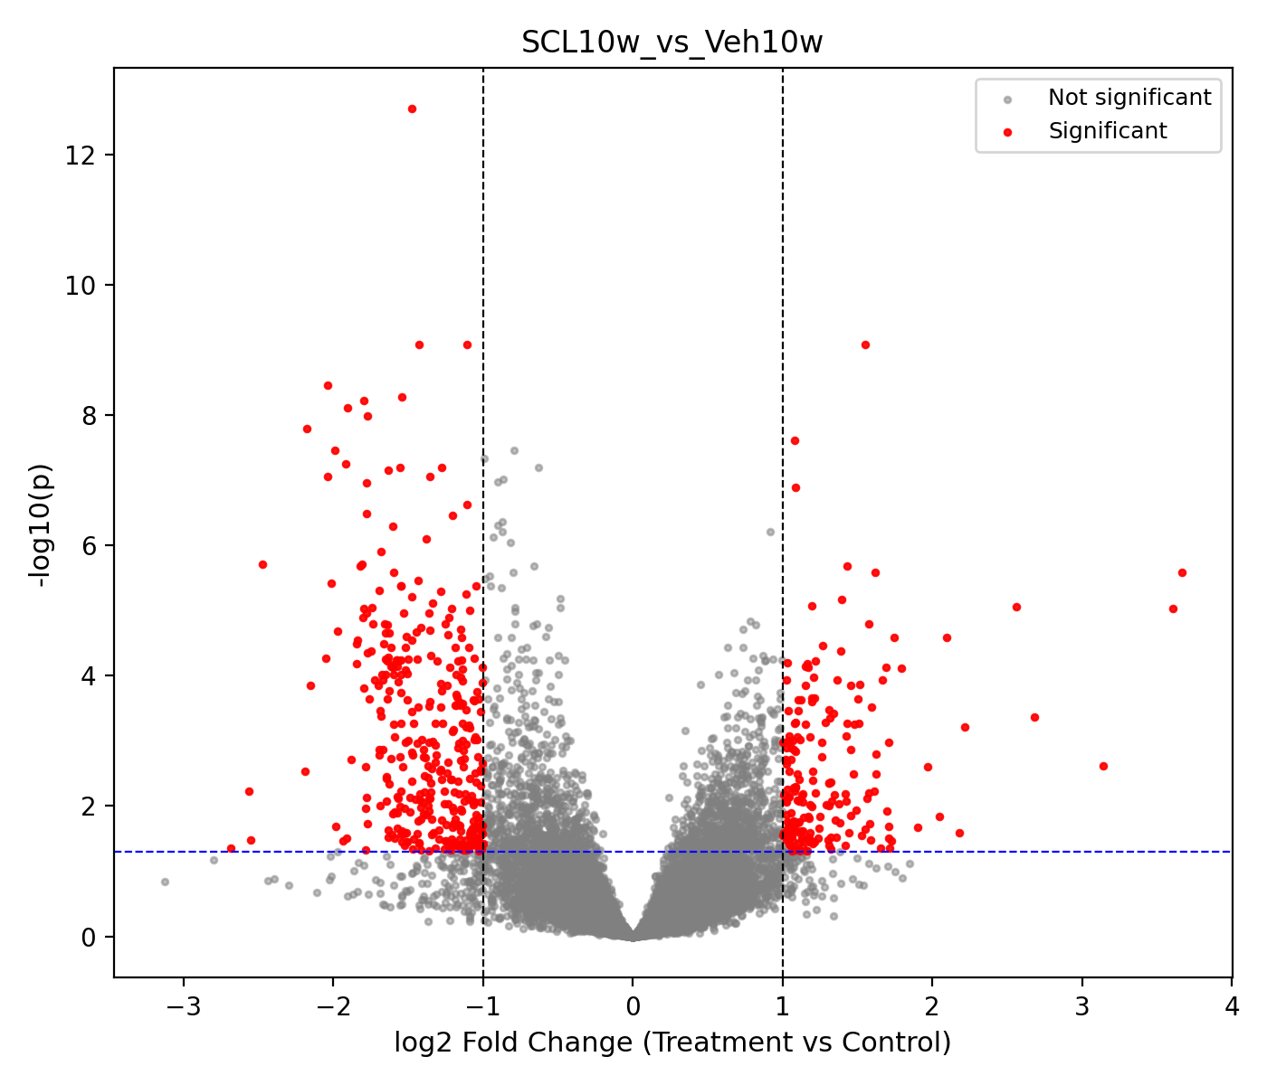
Scl vs Veh
Early stage
Only 3 significant genes, skip for pathway enrichment analysis
late stage
(LogScl10w – Log Scl2w) – (Log Veh10w – Log Veh2w)
DESeq2 interaction model
Notes:
Venn of significant genes

Slide 4
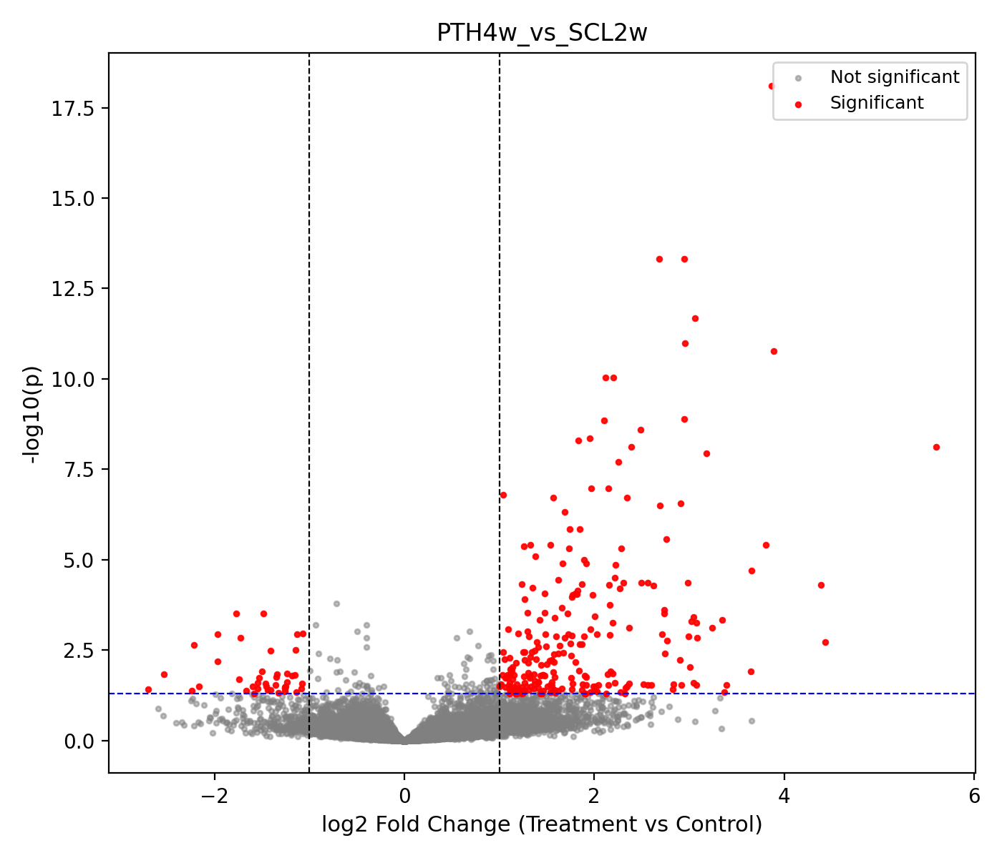
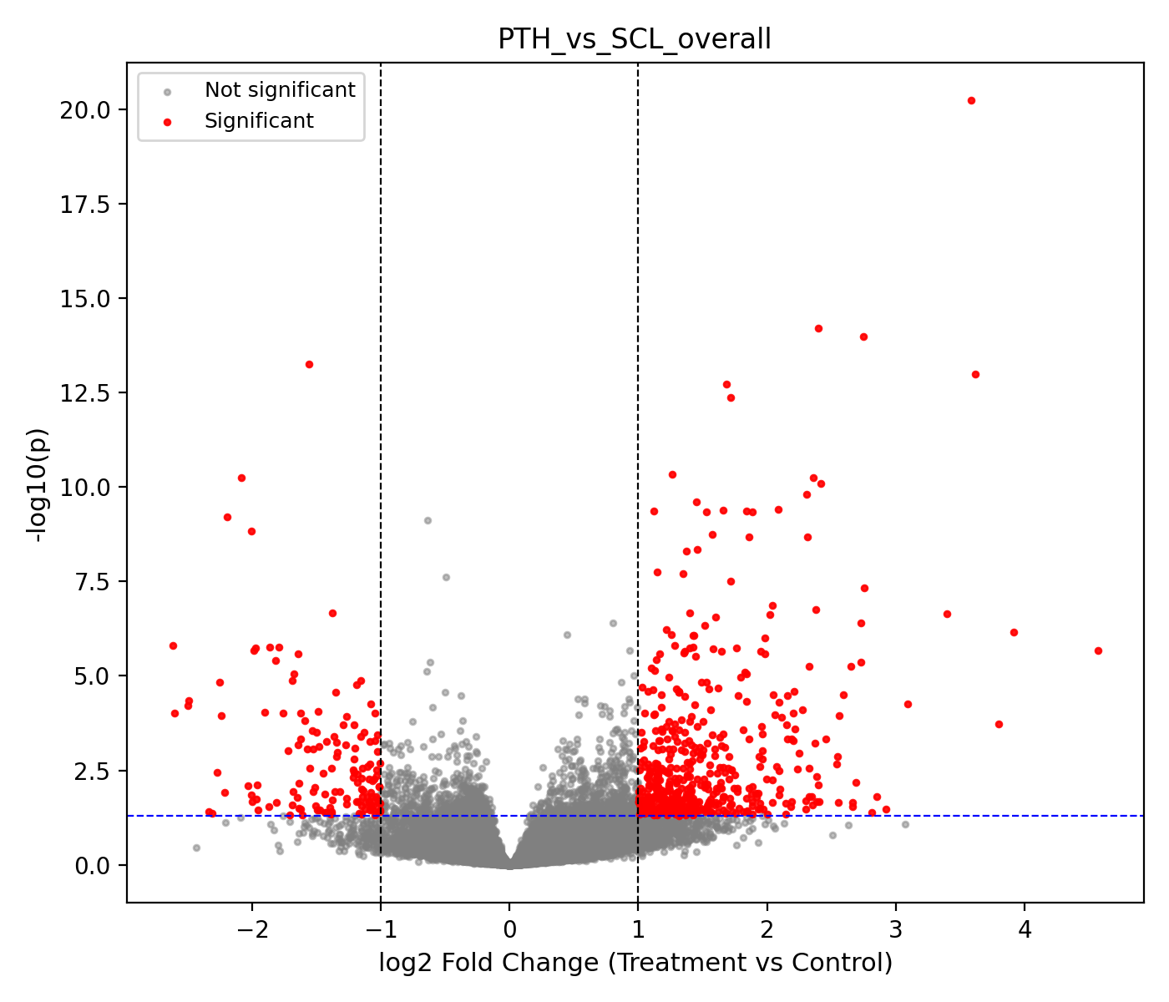
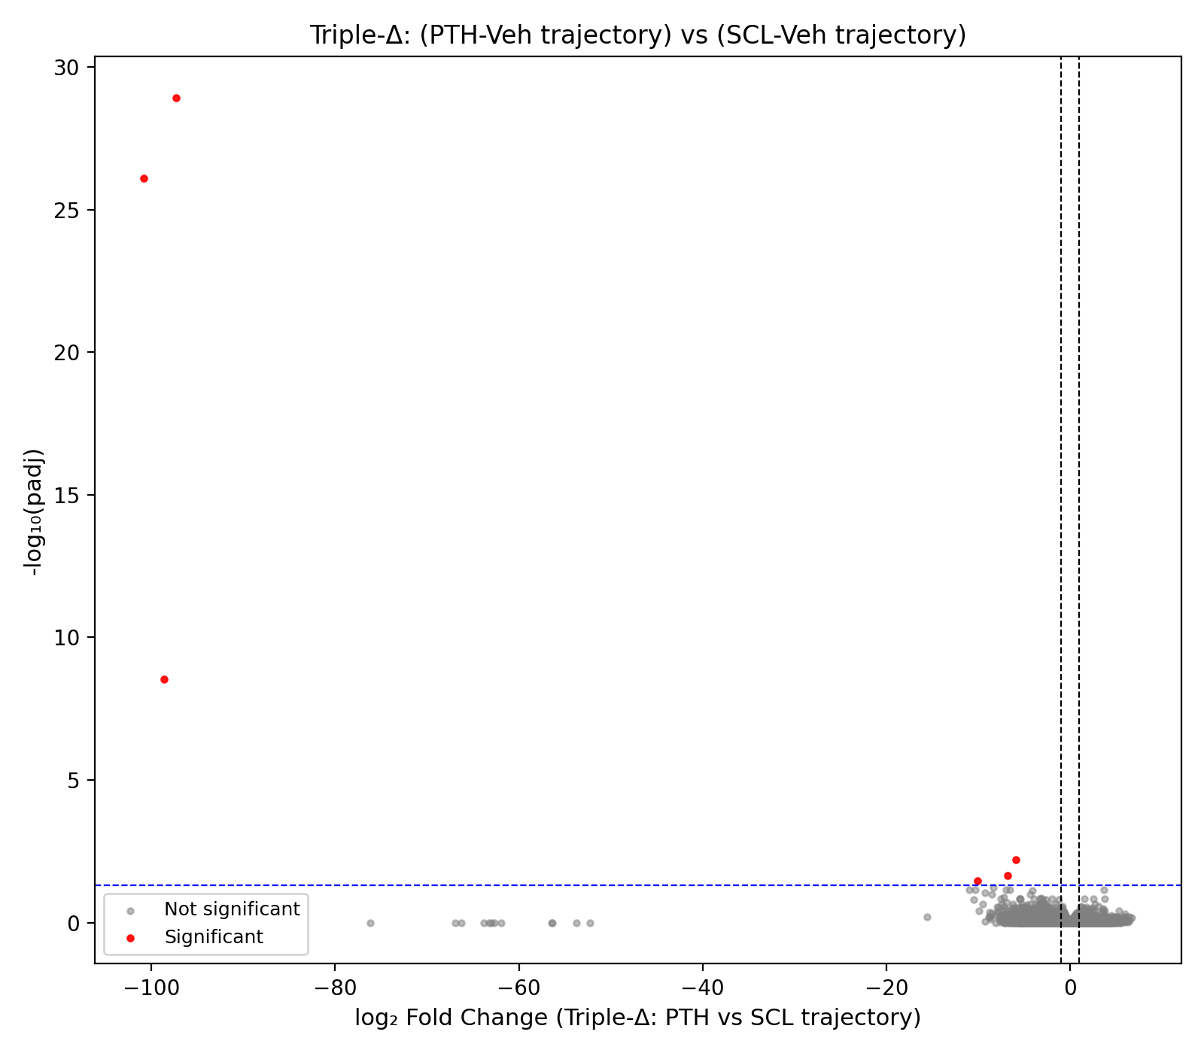
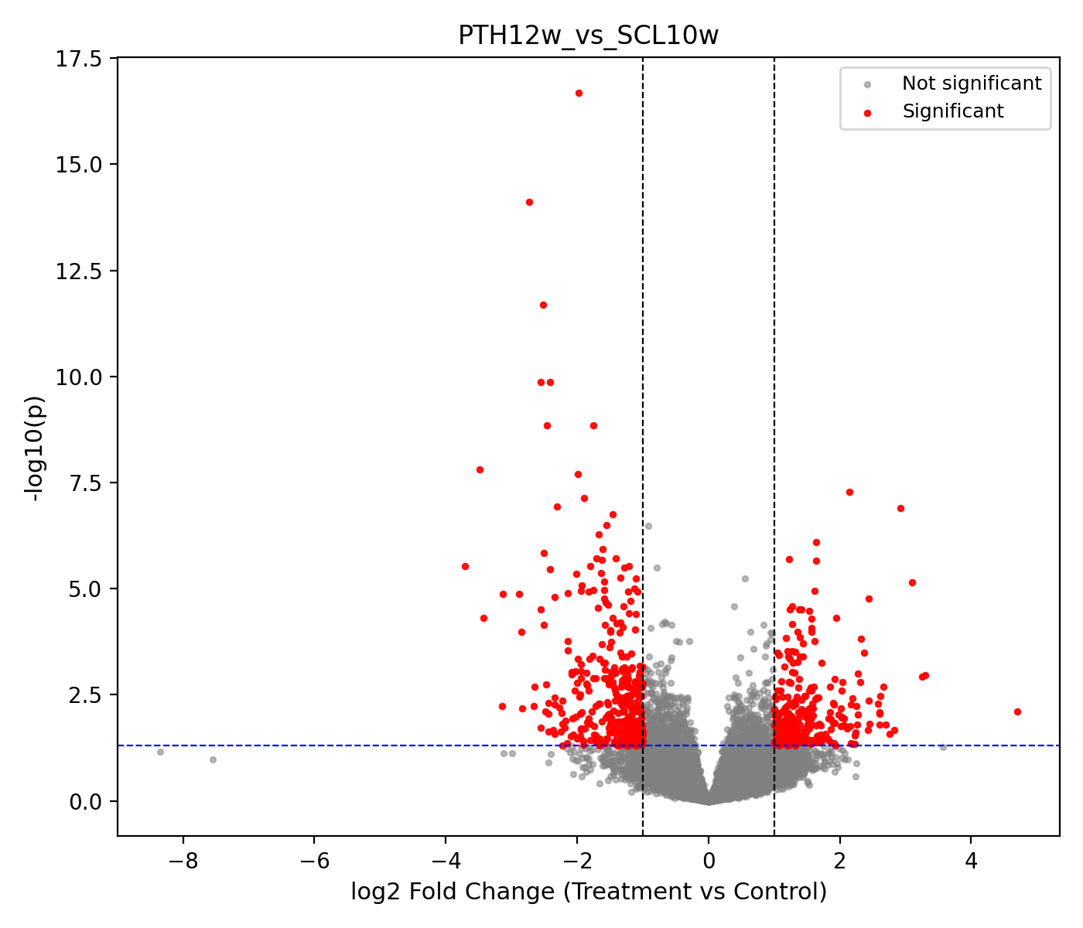
PTH vs Scl
Early stage
(Log mean(PTH all sample)) – (Log mean (Scl all sample))
(LogPTH12w – Log PTH4w) – (Log Scl10w – Log Scl2w)
Warning: This may not be a good compare method!!
late stage

Slide 5
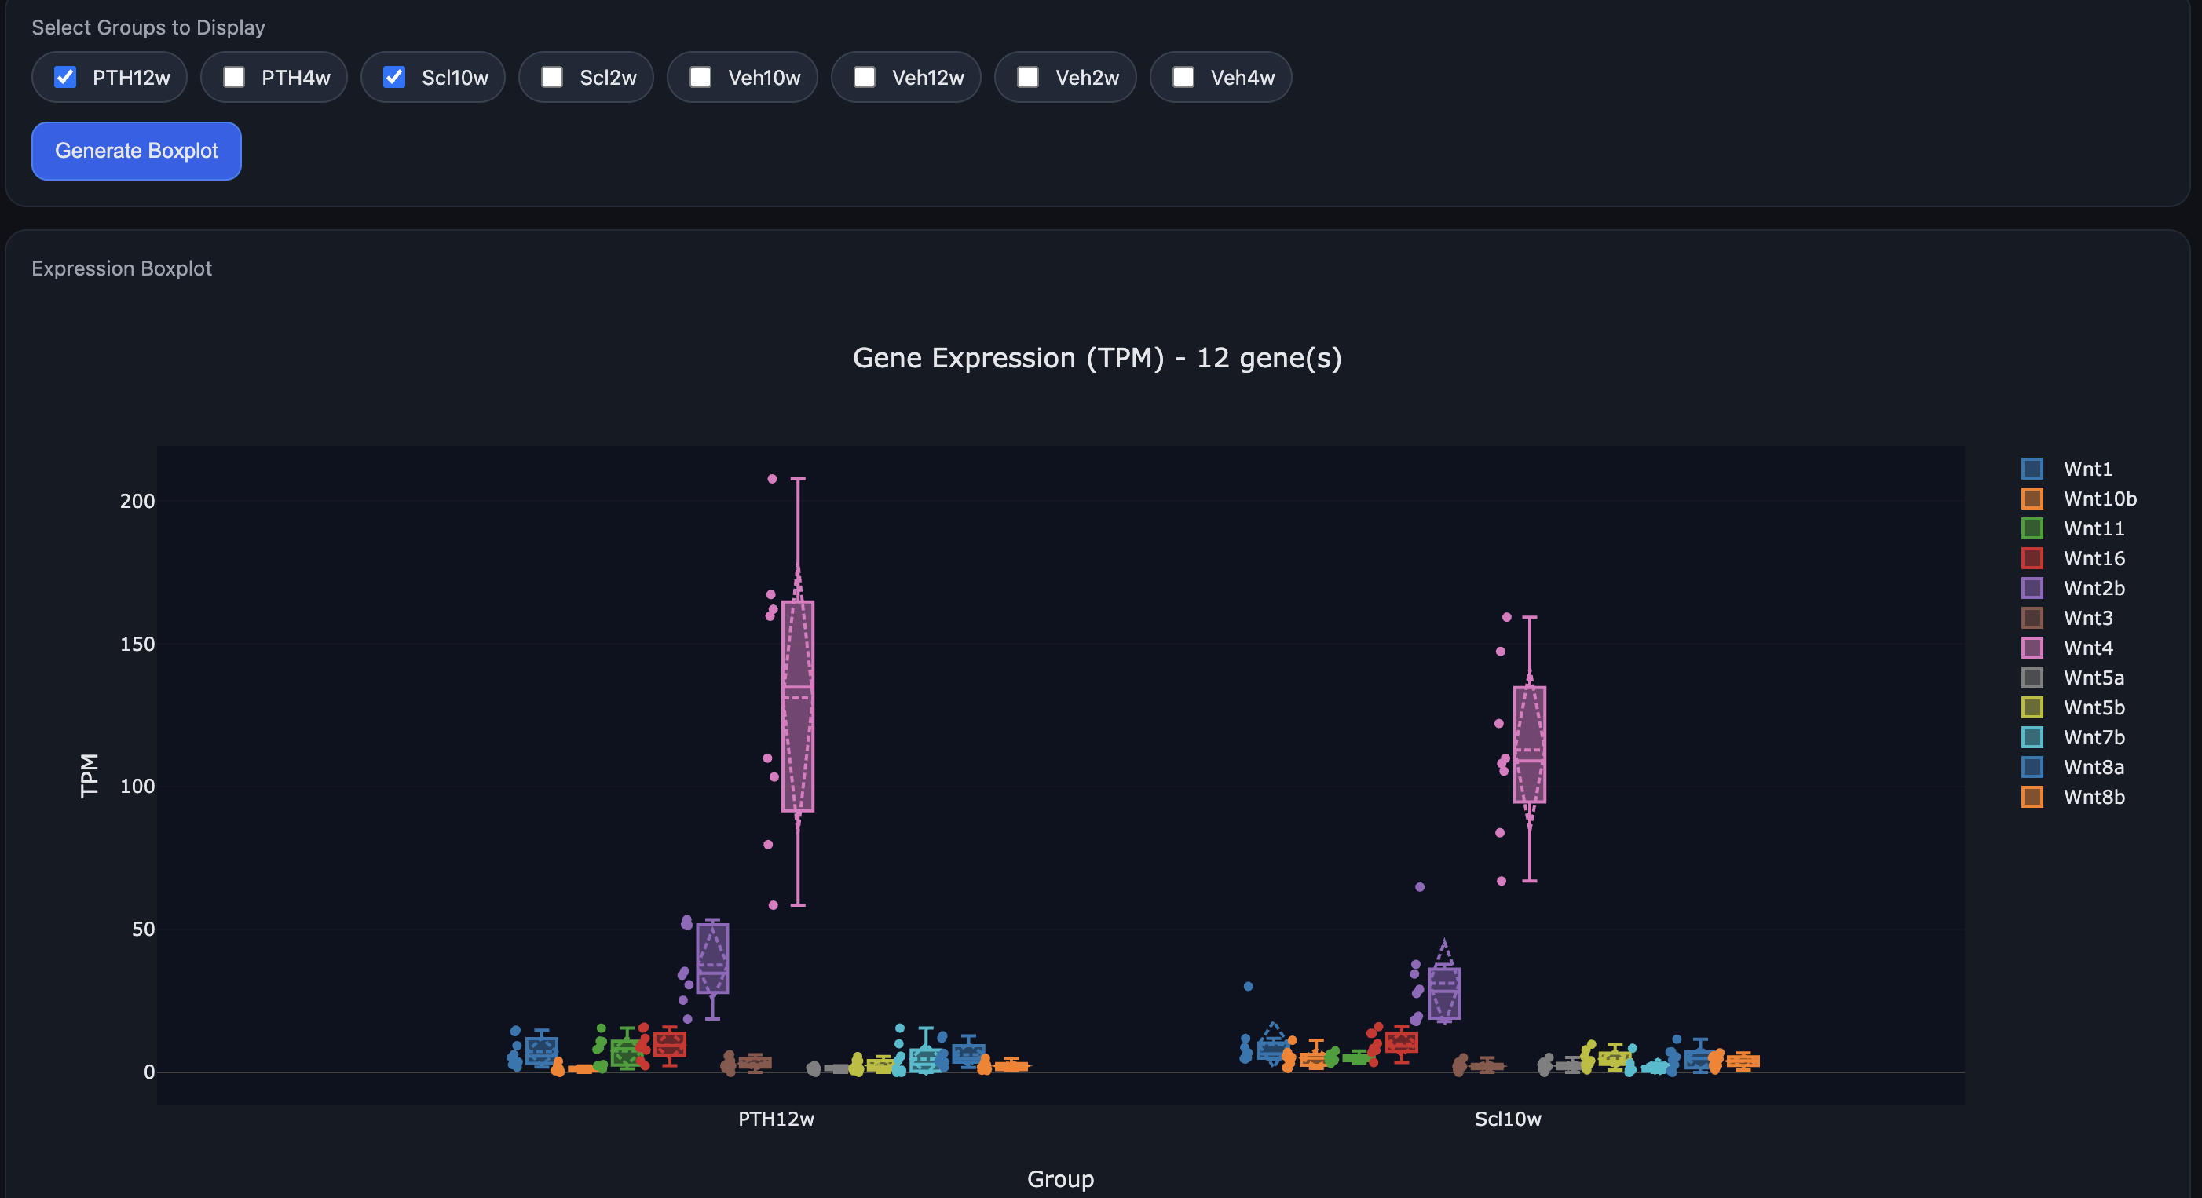
Gene expression viewer (.html)

Slide 6
Pathway analysis
Currently, significant genes are enriched to pathway based on KEGG.
Six group of enriched pathways:
  PTH12w_vs_Veh12w
  PTH4w_vs_Veh4w
  SCL10w_vs_Veh10w
  PTH4w_vs_SCL2w
  PTH12w_vs_SCL10w
  PTH_vs_SCL_overall

Slide 7
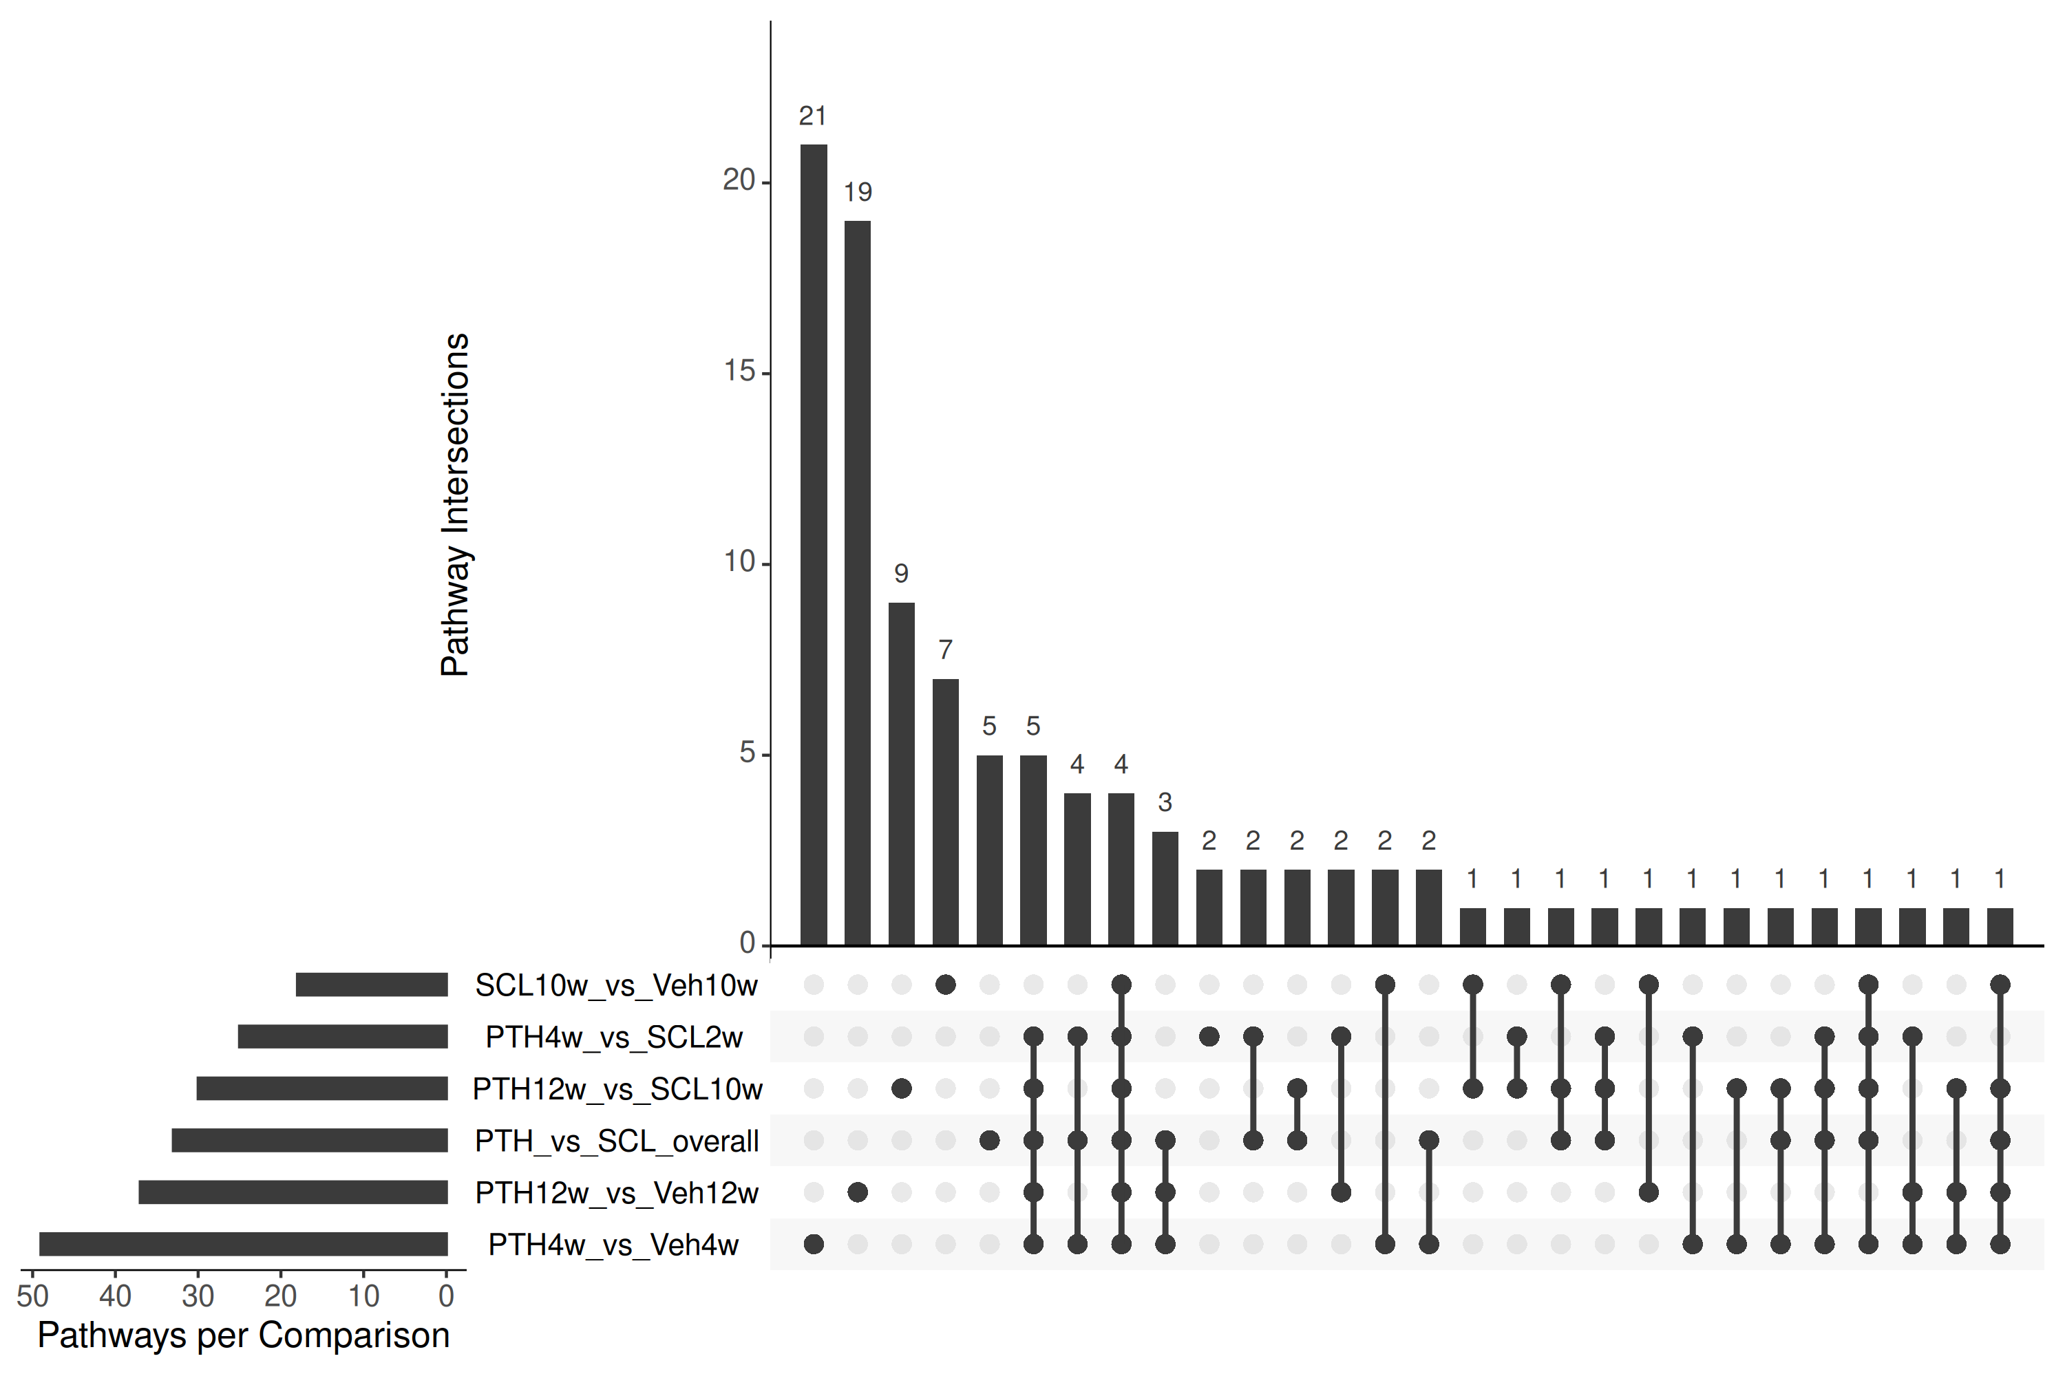
Pathways venn analysis

Slide 8
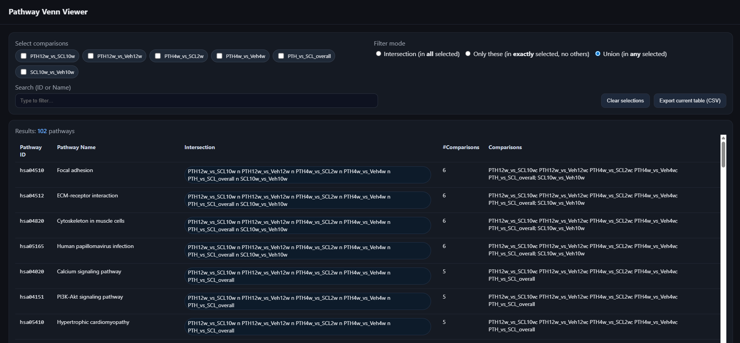
Pathways venn viewer (.html)
Notes:
Put html to my/team Github

Slide 9
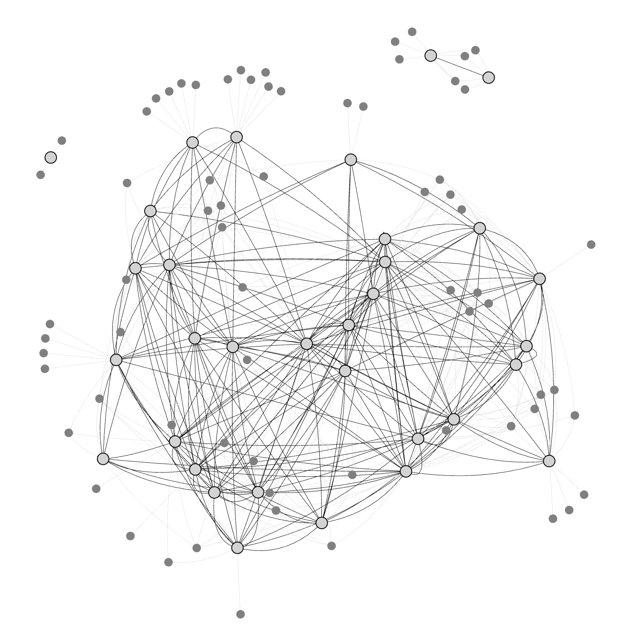
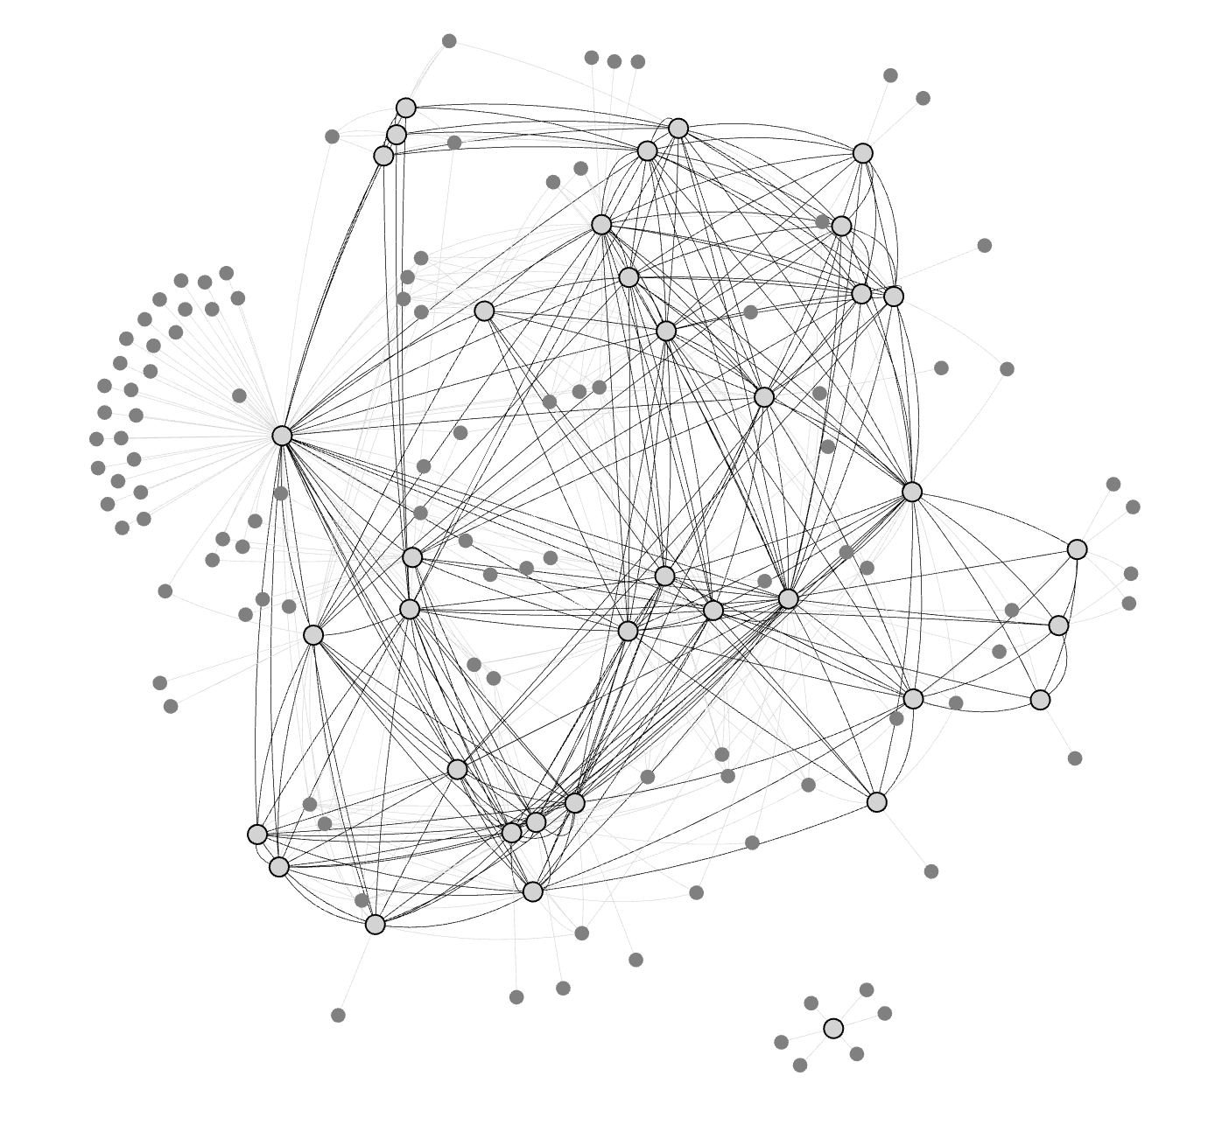
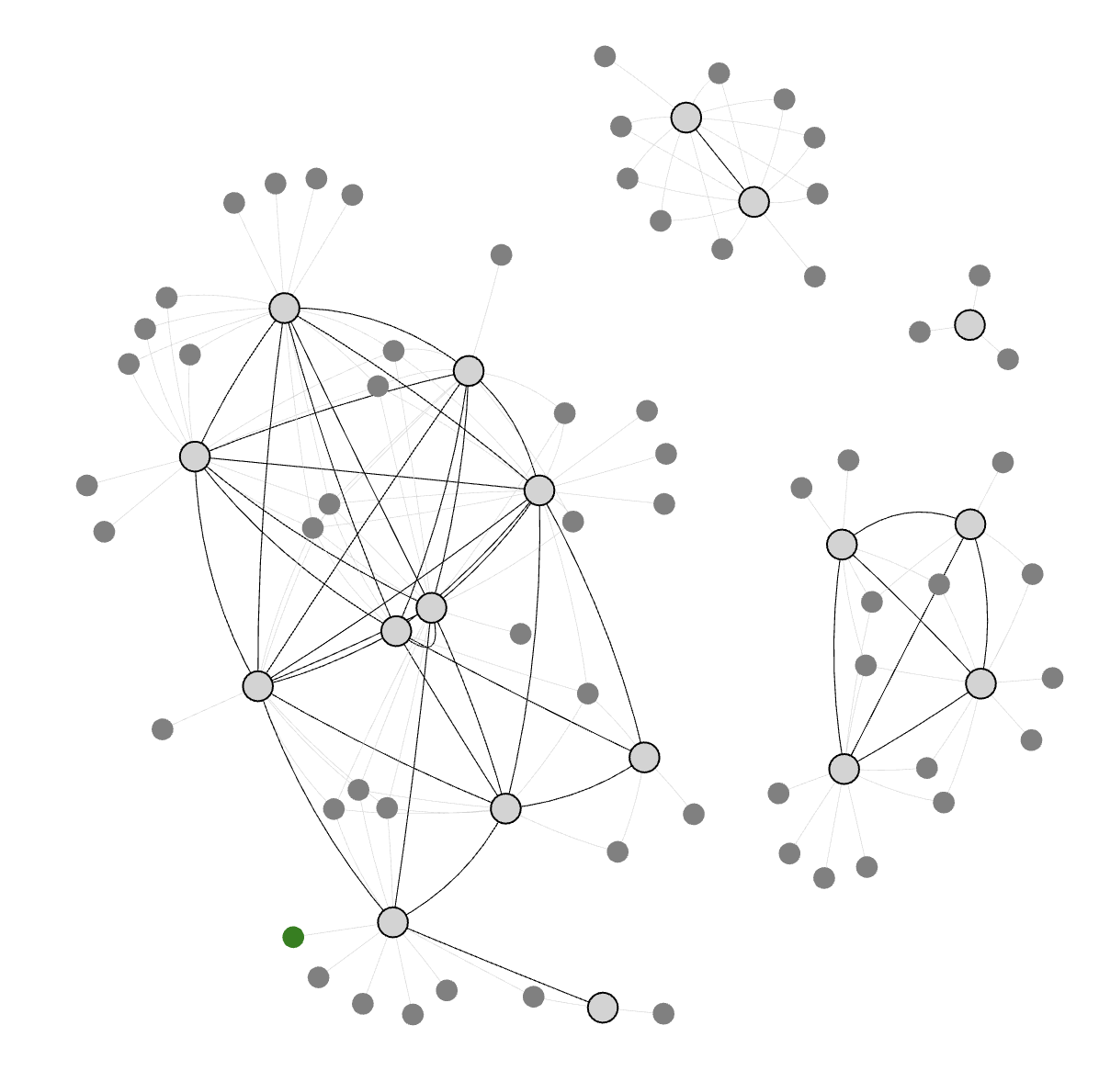
Networks (.html)
PTH12w_vs_Veh12w
PTH_vs_SCL_overall
SCL10w_vs_Veh10w
Notes:
Specific question ? What is common/different group (treatment/time point)? QC?

